Slide 1
Carboxylic acids
Dr Amit Kumar Yadav
Assistant Professor-Chemistry
Mahamaya Government Degree College, Mahona, Lucknow (U.P.)

Slide 2
Organic compounds containing carboxyl
(-COOH) groups are called carboxylic acids
These may be mono, di and tricarboxylic acids
Aliphatic, alicyclic and aromatic
Saturated, unsaturated and substituted
General formula is CnH2nO2

Slide 5
Nomenclature
HCOOH METHANOIC ACID FORMIC ACID
CH3COOH ETHANOIC ACID ACETIC ACID
CH3CH2COOH PROPANOIC ACID PROPIONIC ACID
CH3(CH2)2COOH BUTANOIC ACID n-BUTYRIC ACID
CH3(CH2)8COOH DECANOIC ACID CAPRIC ACID

Slide 6
Structure of the carboxylic acids

Slide 7
Preparation
Oxidation of primary alcohols or aldehydes

Slide 8
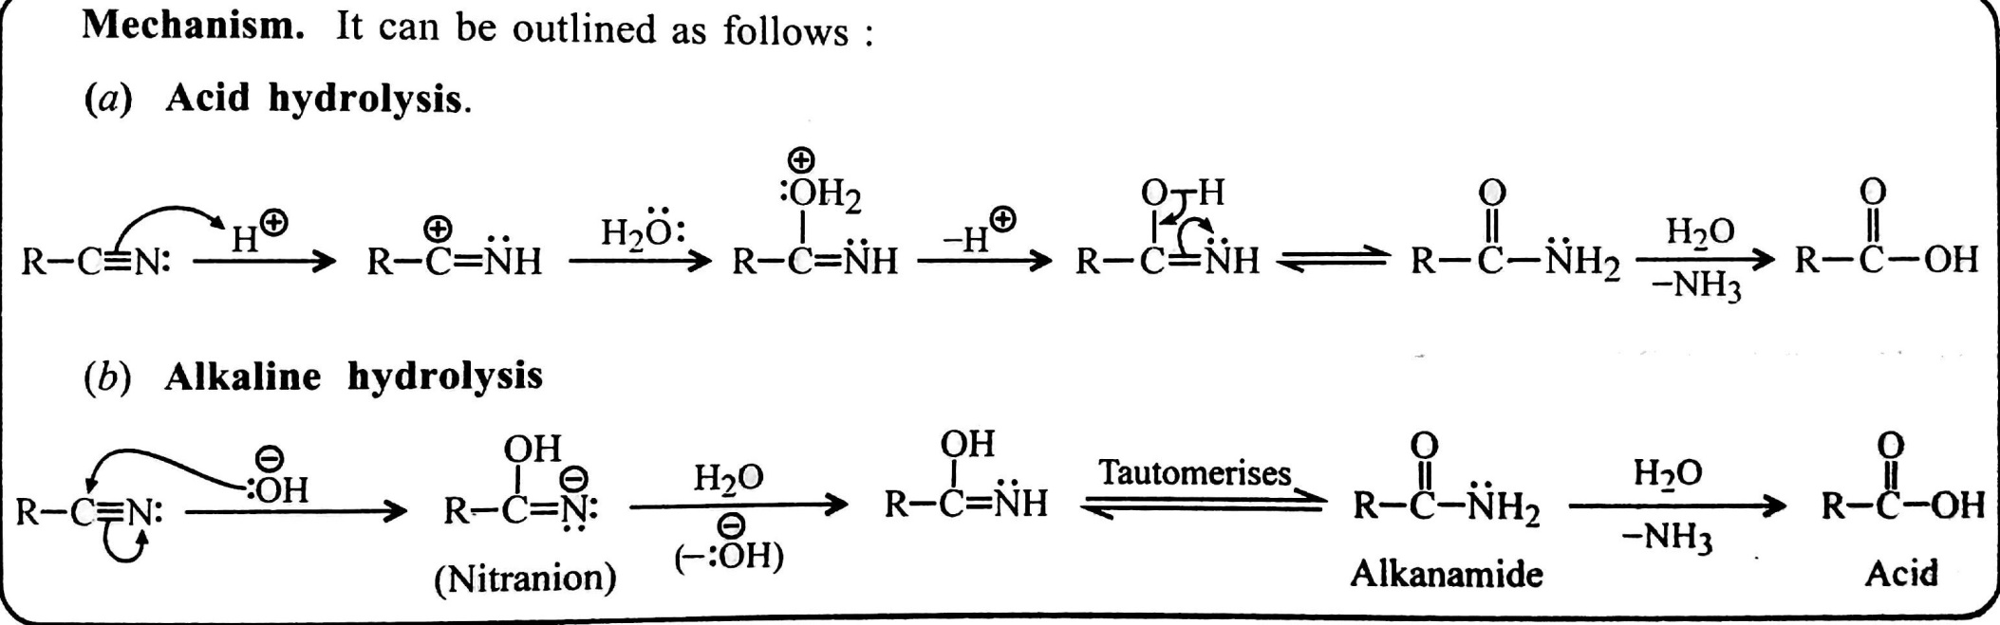
Hydrolysis of cyanides or nitriles

Slide 9
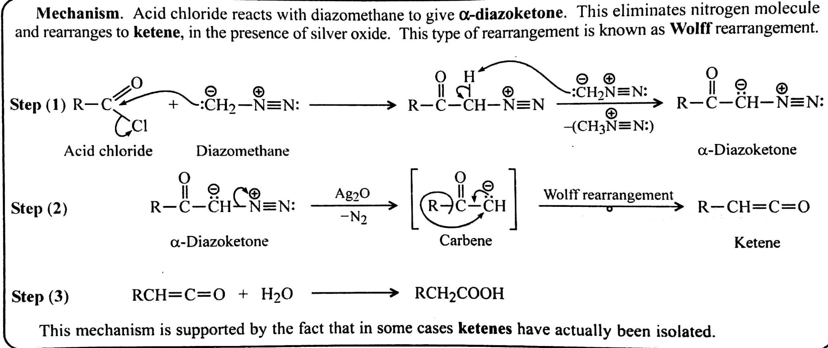
Arndt-Eistert Synthesis

Slide 10
Physical properties
Aliphatic carboxylic acids, except lower members (C1 to C4) are sparingly soluble or insoluble in water, but soluble in less polar solvents like ether
Aromatic carboxylic acids are crystalline solids showing little solubility in water
Water solubility of lower members is due to hydrogen bonding between the carboxylic acid and water
Lower solubility of higher aliphatic acids/ aromatic acids in water is possibly due to their high carbon content and somewhat reduced polarity

Slide 11
Chemical properties
Acidic character-
Substituted acids like ClCH2COOH, Cl2CHCOOH and Cl3CCOOH are stronger acids than acetic acid
Acetic acid is weaker than formic acid

Slide 12
Reaction with alkalies (neutralisation)
Reaction with metals

Slide 13
Conversion into carboxylic acid derivatives

Slide 14
Reduction to alcohols

Slide 15
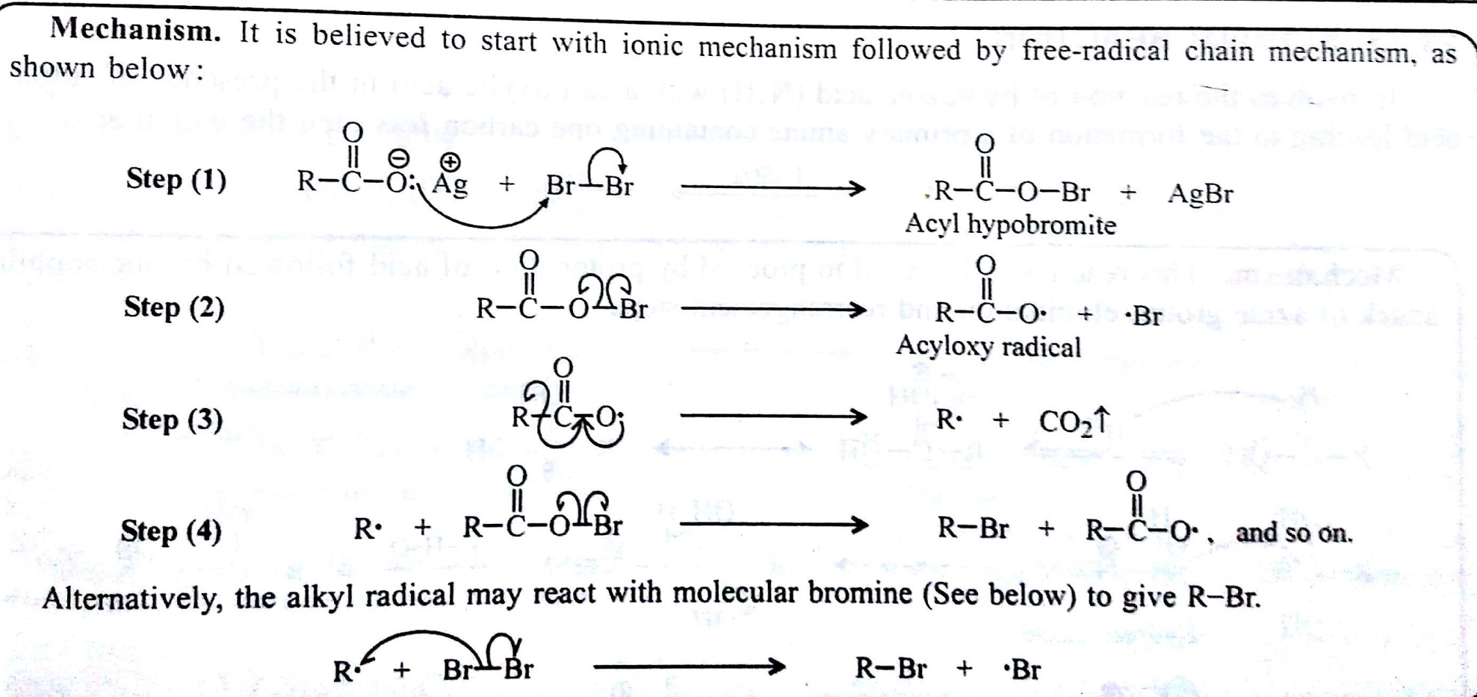
Degradation to alkyl halides
(Hunsdiecker reaction)

Slide 16
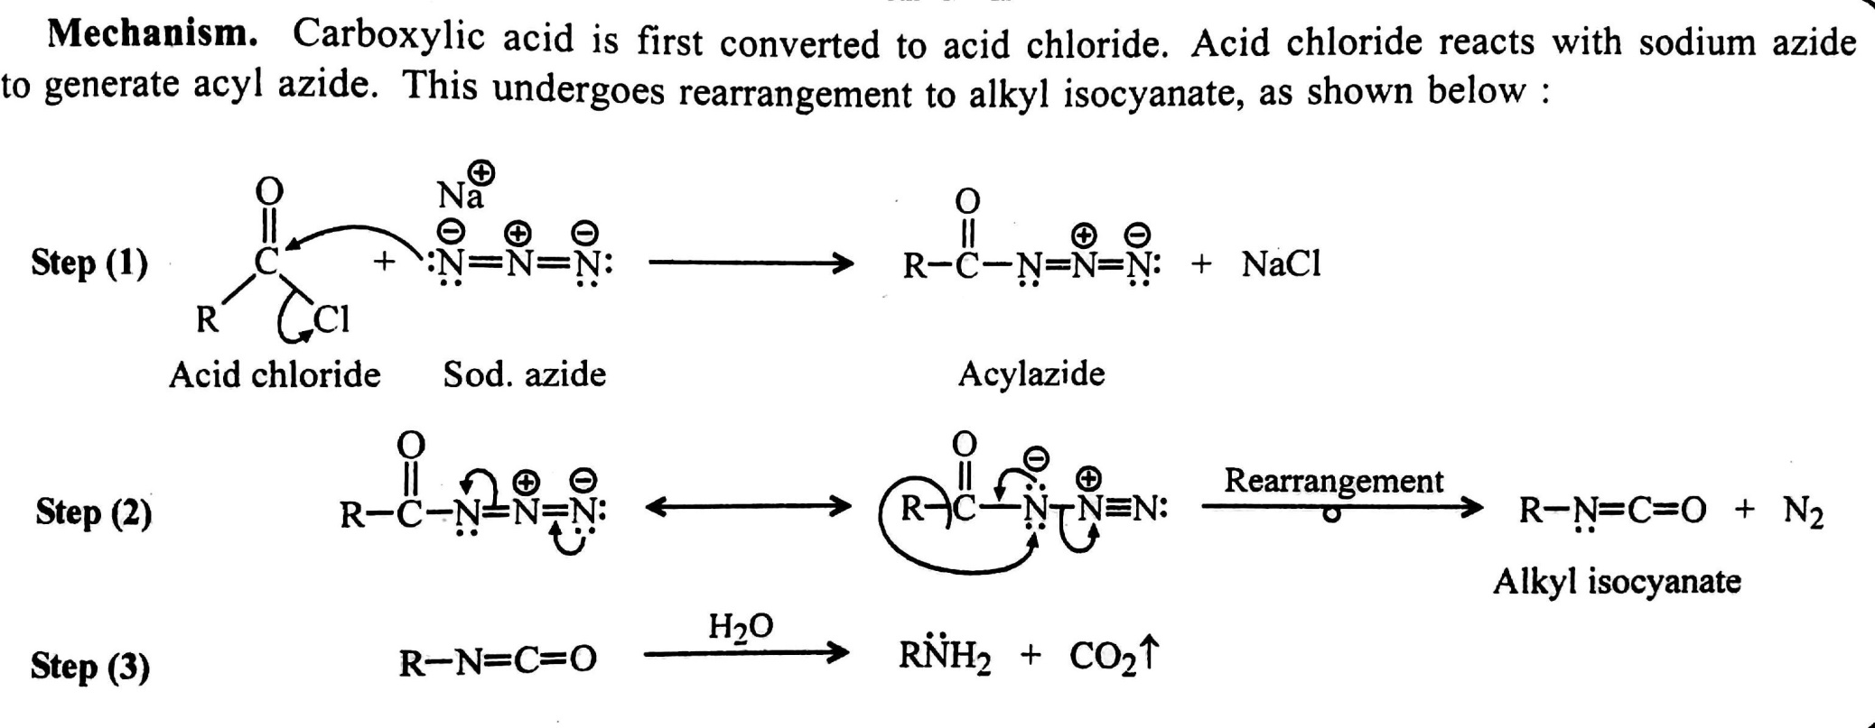
Curtius reaction/Rearrangement

Slide 17
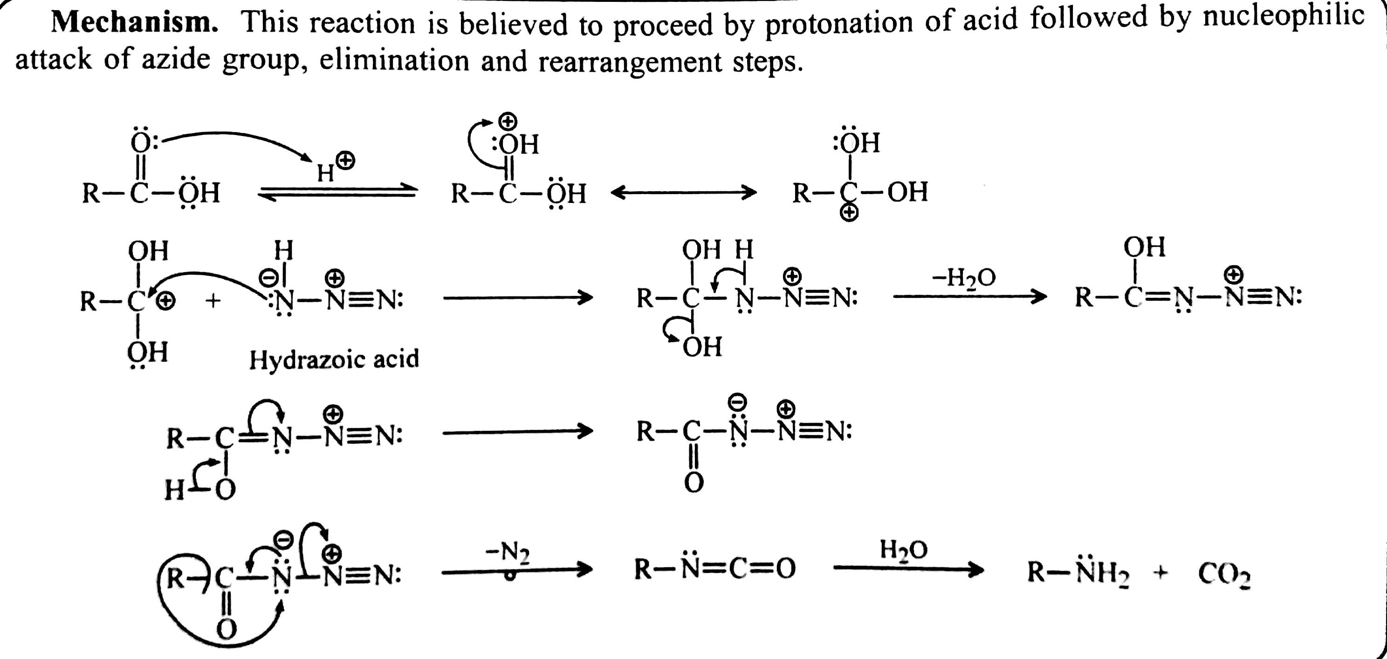
Schmidt reaction

Slide 18
Reaction with organometallics
Decarboxylation

Slide 19
Conversion into aldehydes and ketones
Substitution in the alkyl groups/side-chains

Slide 20
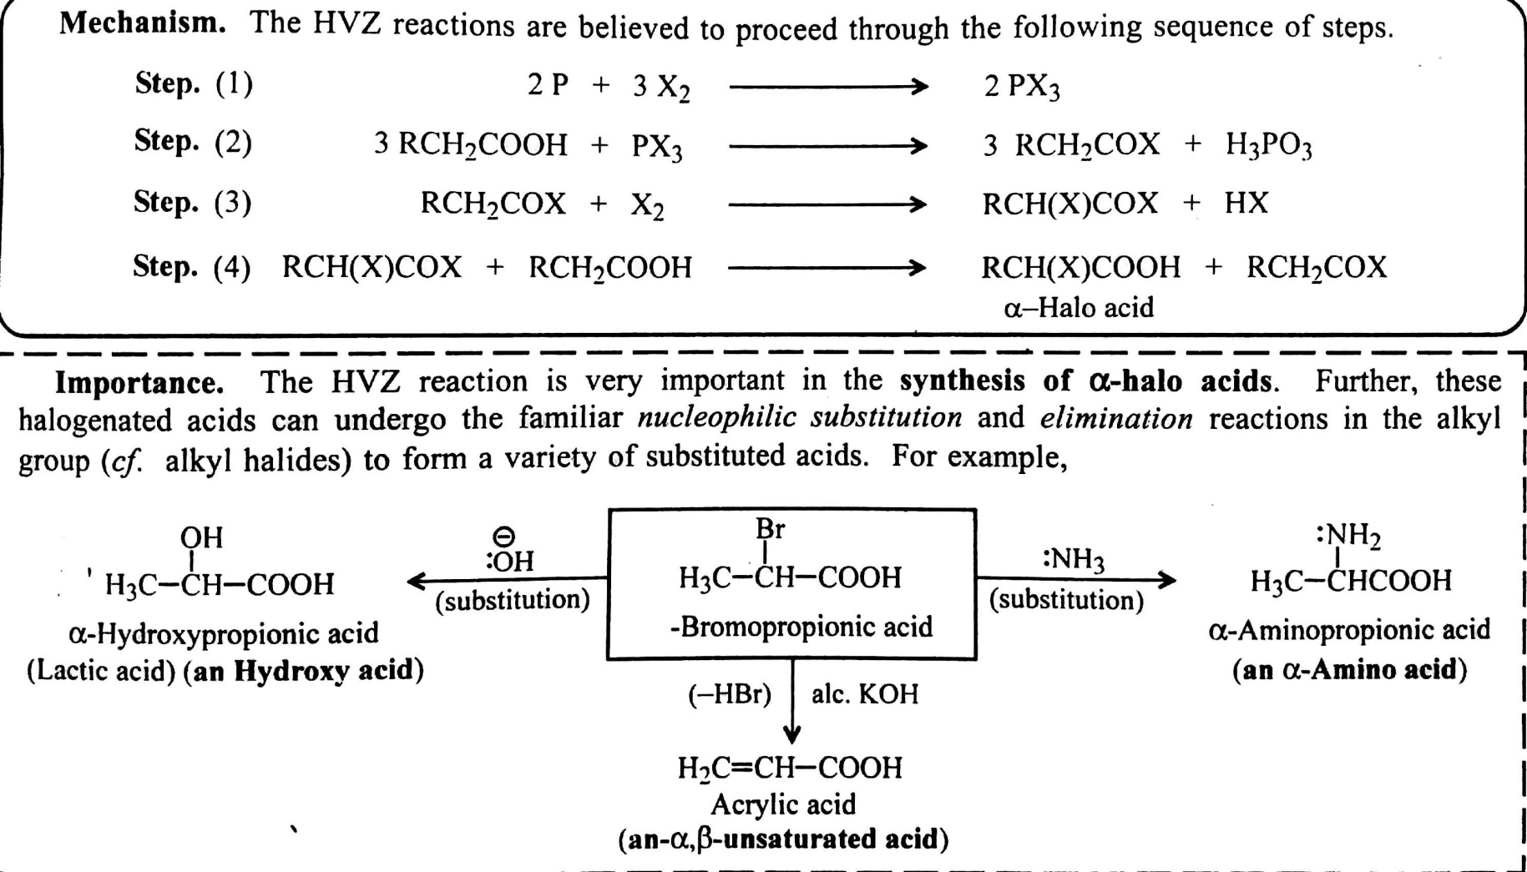
Hell-Volhard Zelinsky (HVZ) reaction

Slide 21
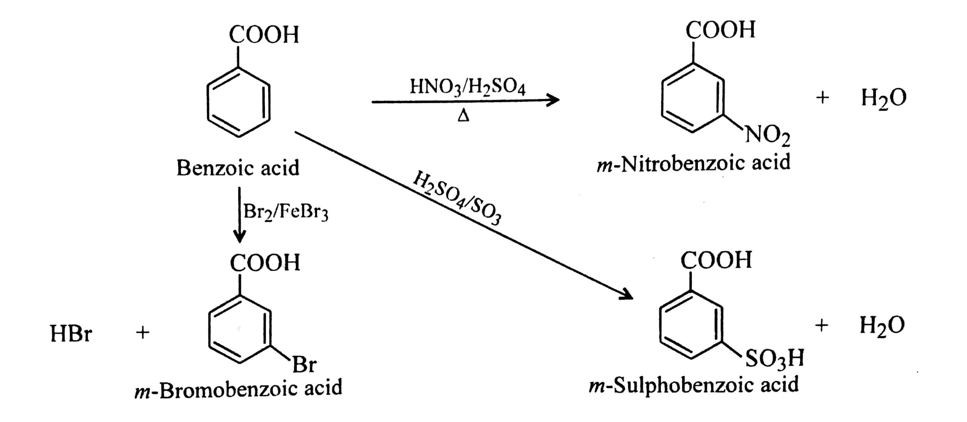
SUBSTITUTION IN THE BENZENE RING

Slide 22
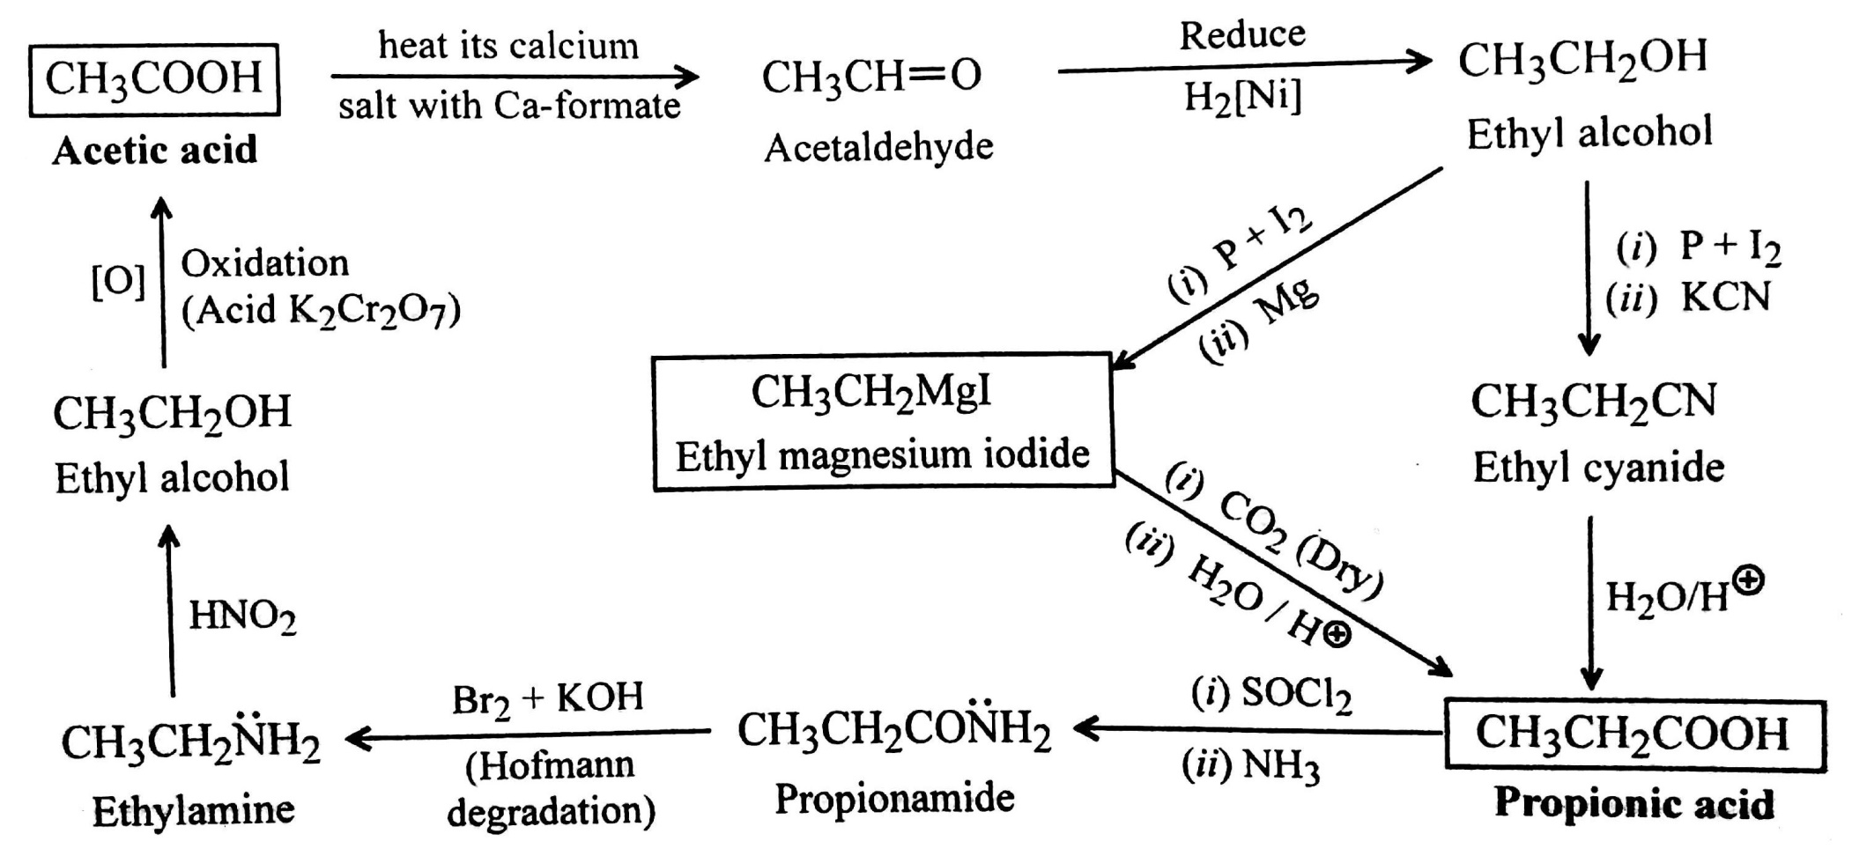
ASCENT AND DESCENT OF FATTY ACIDS

Slide 23
THANKS

